Slide 1

EDA Project on
A Data-Driven Study of Wireless Earbuds Pricing and Customer Preferences
Presented by : Udvisha Kosti
Batch no : 456
INNOMATICS RESEARCH LABS
DISUKHNAGAR BRANCH

Slide 2
Agenda
Introduction & Project Background
Problem Statement
Objectives of the Study
Dataset Overview
Exploratory Data Analysis (EDA)
Key Insights & Findings
Business Implications
Conclusion & Recommendations

Slide 3
Introduction
In today’s digital marketplace, wireless earbuds have become an essential consumer product. With numerous brands, price ranges, and technical features available online, customers often face difficulty in choosing the right product that offers true value for money.
This project applies Exploratory Data Analysis (EDA) to understand how factors such as price, discounts, Bluetooth versions, and customer ratings influence purchasing decisions. The goal is to simplify product selection using data-driven insights rather than assumptions or marketing claims.

Slide 4
Business Problem:
In the highly competitive online consumer electronics market, customers are presented with hundreds of wireless earbuds that appear similar in features but vary significantly in price, discounts, and brand positioning. Despite having access to abundant information, customers struggle to identify products that genuinely offer value for money.

Slide 5
Key Questions This Project Answers
This analysis tries to answer:
Is higher price really worth it?
Do higher discounts mean better value?
Do premium brands get better ratings?
Does a higher Bluetooth version increase price?
Which feature combination gives best value for money?

Slide 6
Objective of the Project
The primary objective of this project is to use Exploratory Data Analysis (EDA) to identify the key factors that truly influence value for money and customer satisfaction in the wireless earbuds market.
Understand pricing patterns
Study discounts vs ratings
Analyse technology (Bluetooth versions)
Identify what truly influences customer satisfaction.

Slide 7
Data Overview :
The dataset includes:
Brand Noise, boat, JBL, OnePlus, Boult, etc.
Bluetooth Version 5.0, 5.1, 5.2, 5.3
Colour Product colour
MRP Original price
Selling Price Discounted price
Discount Percentage Price reduction rate
Discount Amount Savings value
Customer Ratings User feedback score

Slide 8
Web Scraping: Details
Web Scraping – Project Details
Website Source: E-commerce platform (Wireless Earbuds listings)
Tools Used: Python, Selenium, Requests
Purpose: To collect real-world market data for analysis
Scraping Approach
Crawled multiple paginated product listing pages
Handled dynamic content loading using Selenium
Extracted structured product-level information
Stored scraped data into a Pandas Data Frame for analysis

Slide 9
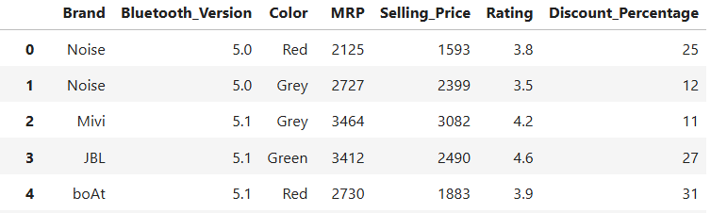
Summary Of The Data
430+ earbud variants
7 columns: Brand, Bluetooth Version, Color, MRP, Selling Price, Rating, Discount Percentage
Multiple brands included: Noise, boat, JBL, OnePlus, Boult ,etc.

Slide 10
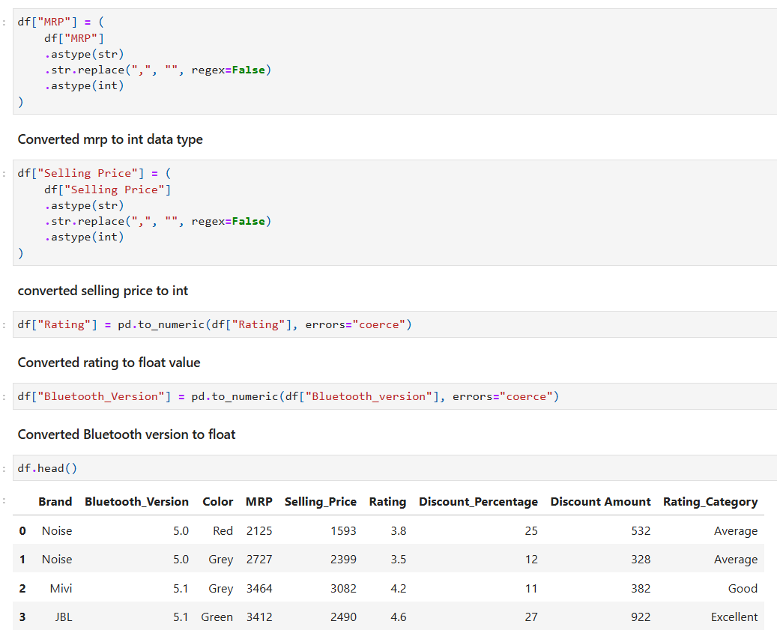
Data Cleaning
Converted MRP from string to integer by removing commas
Converted Selling Price from string to integer by removing commas
Converted Rating column to numeric (float) using coercion for invalid values
Converted Bluetooth Version to numeric format
Handled missing values in numeric columns using median imputation
Capped Discount Percentage values above 90 to avoid unrealistic discounts
Ensured all numeric columns have correct and consistent data types

Slide 11
Data Manipulation
Standardized pricing data for analysis
Created discount-related features
Applied conditional updates
Prepared data for visualization & insights

Slide 12
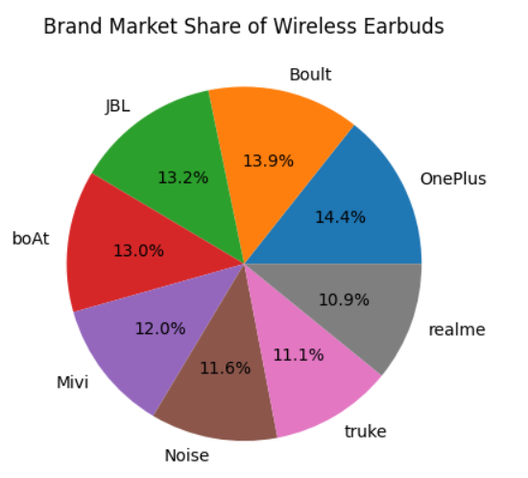
Univariate Analysis
Univariate Analysis is the analysis of a single variable at a time to understand its distribution, pattern, and basic characteristics.
Which wireless earbud brands have the highest market presence in the dataset?
Insight : Some brands dominate the dataset, indicating higher market presence and availability

Slide 13
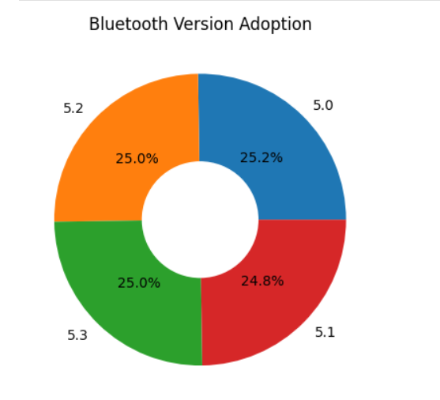
Which Bluetooth versions are most commonly adopted in wireless earbuds?
Insight: Higher Bluetooth versions (5.2, 5.3) appear more frequently, showing a shift toward newer technology.

Slide 14
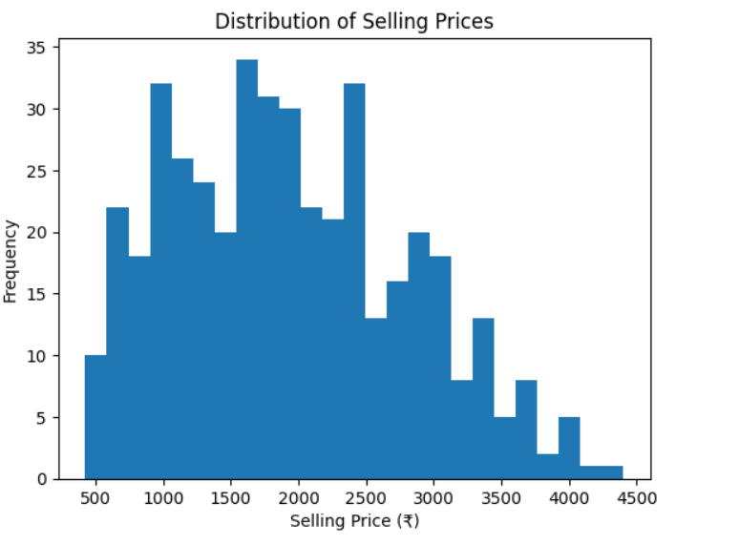
What price range do most wireless earbuds fall into?
Insight: Most earbuds fall into the budget to mid-range price segment, with fewer premium products.

Slide 15
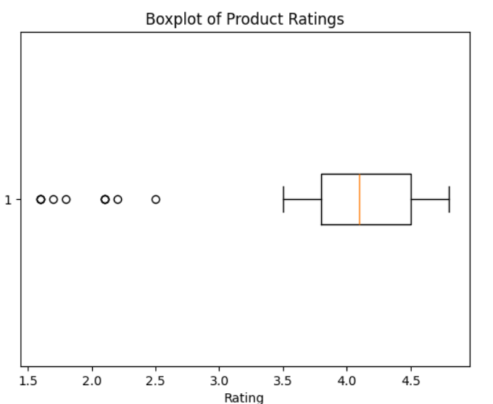
How consistent is customer satisfaction across products, and are there rating outliers?
Insight: Most ratings are concentrated between 3.5 and 4.8, while a few low-rating outliers exist.

Slide 16
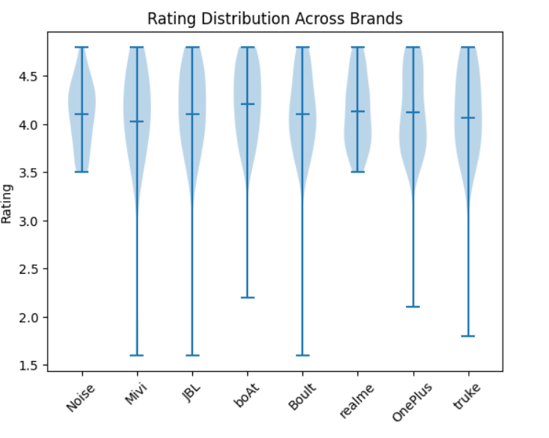
Bivariate Analysis
Bivariate analysis studies the relationship between two variables to understand how one influences the other.
Does customer satisfaction vary by brand?
Insight: Some brands show consistently higher customer satisfaction, while others have wider rating variation.

Slide 17
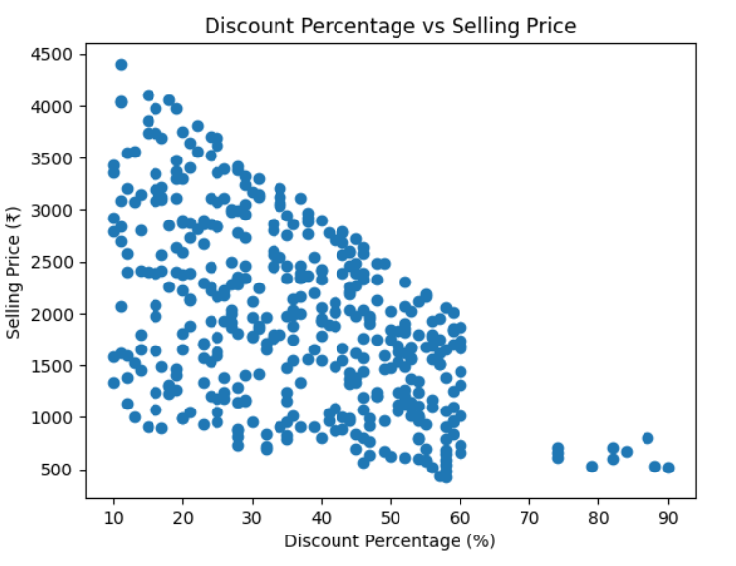
How do discounts influence the final selling price?
Insight: Higher discounts are generally associated with lower selling prices, highlighting aggressive pricing strategies.

Slide 18
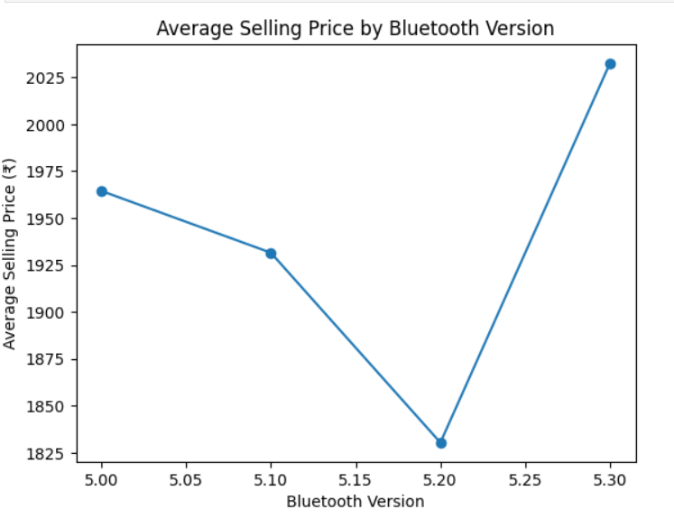
Does Bluetooth version affect the selling price?
Insight: Newer Bluetooth versions tend to have slightly higher average prices, reflecting added features and technology.

Slide 19
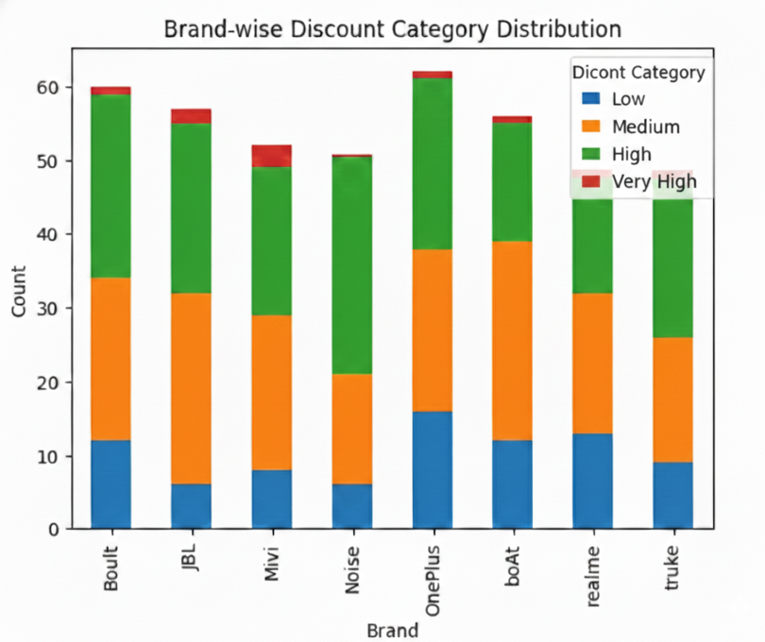
Do brands rely on different discounting strategies?
Insight: Some brands rely heavily on high discounts, while others maintain stable pricing with fewer aggressive offers.

Slide 20
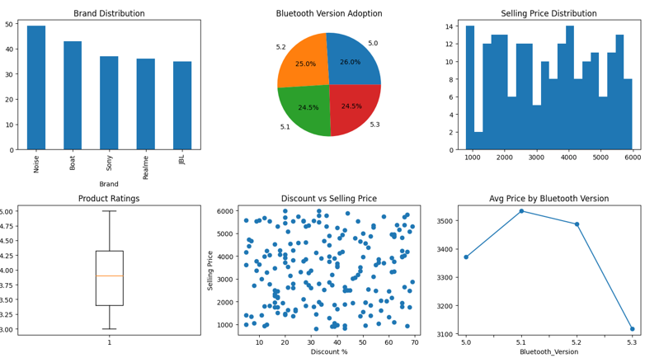
DASHBOARD OVERVIEW

Slide 21
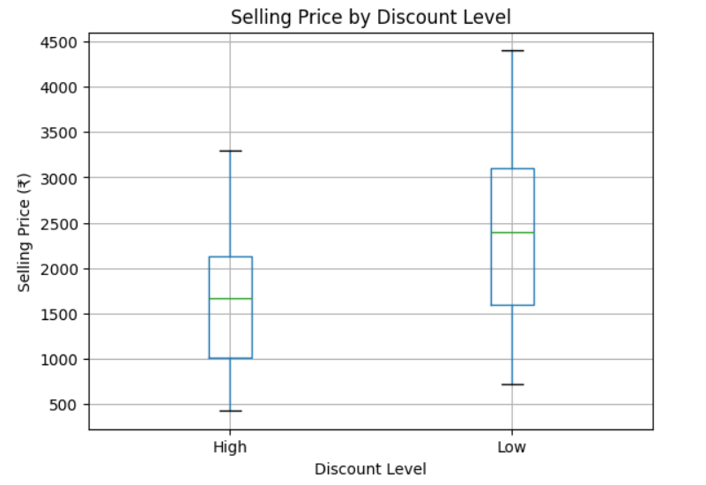
Hypothesis Test 1: Discount vs Selling Price
Do higher discounts lead to lower selling prices?
Hypotheses
H₀: Selling price is the same for high and low discounts
H₁: High-discount products have lower selling prices
Test & Result
Test Used: Independent t-test
Result: Statistically significant difference observed
Business Conclusion
Higher discounts significantly reduce selling prices.

Slide 22
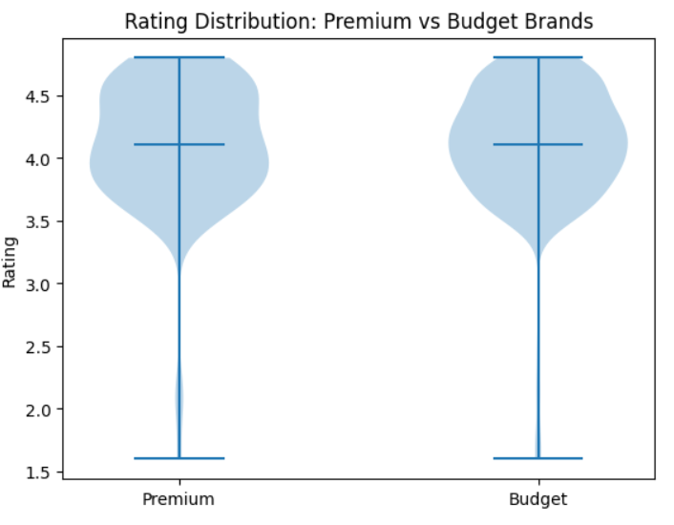
Hypothesis Test 2 : Premium vs Budget Brand Ratings
Do premium brands receive better customer ratings than budget brands?
Hypotheses
H₀: No difference in ratings between premium and budget brands
H₁: Premium brands have higher ratings
Test & Result
Test Used: Independent t-test
Result: Statistically significant difference found
Business Conclusion
Premium brands tend to receive higher customer ratings.

Slide 23
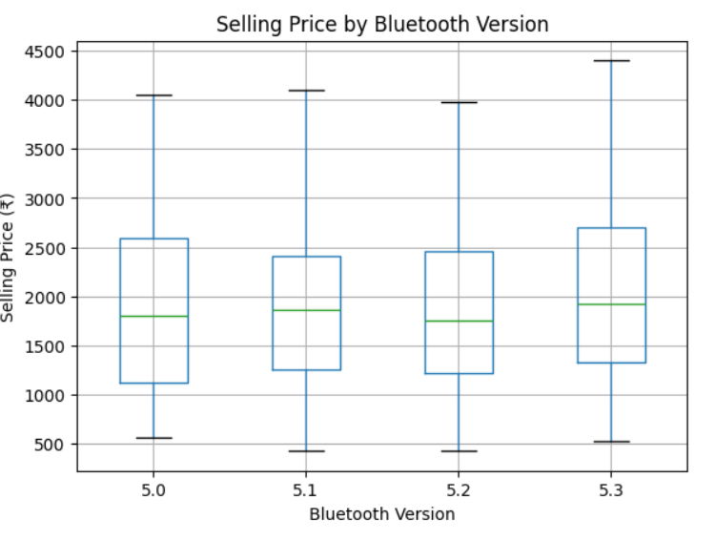
Hypothesis Test 3 : Bluetooth Version vs Selling Price
Is selling price different across Bluetooth versions?
Hypotheses
H₀: Selling price is the same across all Bluetooth versions
H₁: At least one Bluetooth version differs in price
Test & Result
Test Used: One-way ANOVA
Result: Significant price variation observed
Business Conclusion
Bluetooth version influences product pricing.

Slide 24
Conclusions(key findings)
The wireless earbuds market is highly competitive, with no single brand dominating.
Bluetooth 5.x versions are widely adopted, showing fast technology standardization.
Most products fall in the budget to mid-range price segment, indicating price-sensitive demand.
Customer ratings are generally high and consistent, reflecting overall good satisfaction.
A few low-rating outliers suggest quality gaps in certain products.
Higher discounts lead to lower selling prices, confirming discount-driven sales strategies.
Newer features support higher pricing, reducing dependence on heavy discounts.

Slide 25
Challenges and Key Learnings
Handling inconsistent data formats across brands and features.
Managing outliers in prices and ratings that could skew analysis.
Choosing the right visualization to clearly represent insights.
Interpreting discount-heavy pricing without misleading correlations.
Balancing technical accuracy with business-friendly explanations.
Learned how to apply univariate and bivariate analysis for real business problems.
Gained experience in selecting appropriate charts for different data types.
Improved ability to convert raw data into actionable insights.
Understood how pricing, discounts, and features influence customer behavior.
Strengthened data storytelling skills for presentations and decision-making.

Slide 26


